Slide 1

Moonmilk Amplicon Analysis
Sophia Aredas and Havi Rojer

Slide 2
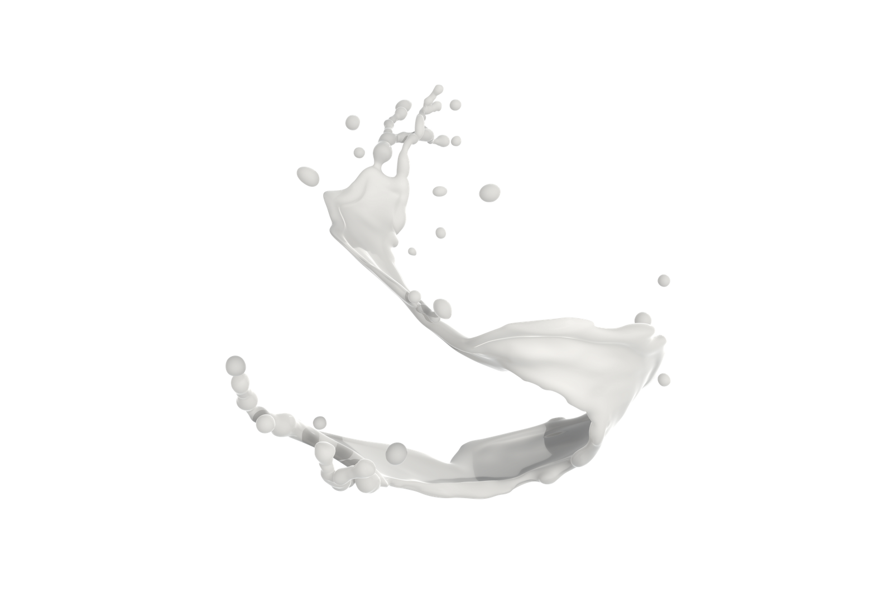
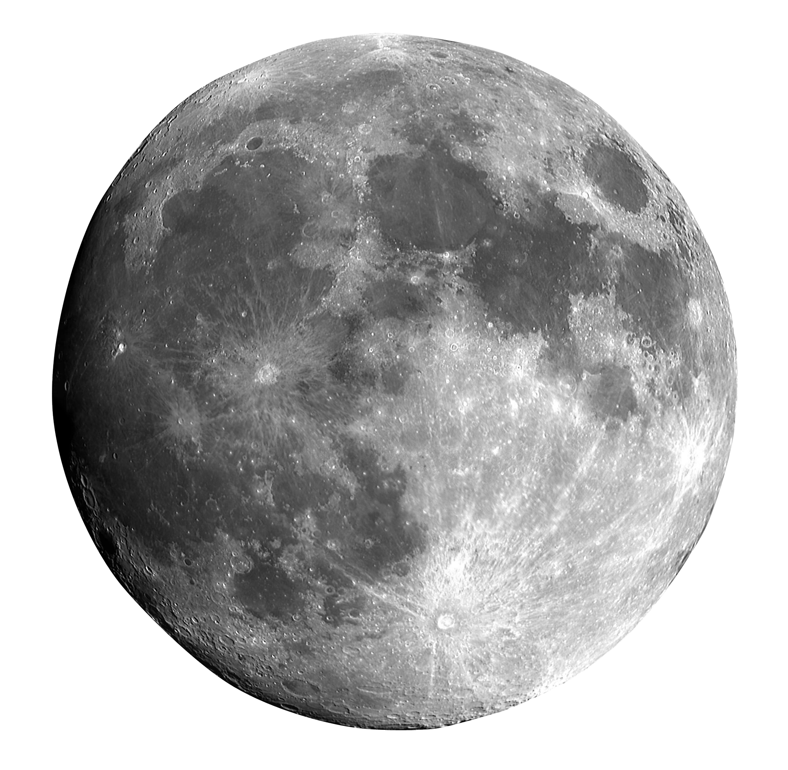
What is Moonmilk?
Notes:
We could also men

Slide 3

It’s not real milk.
Notes:
We could also men

Slide 4
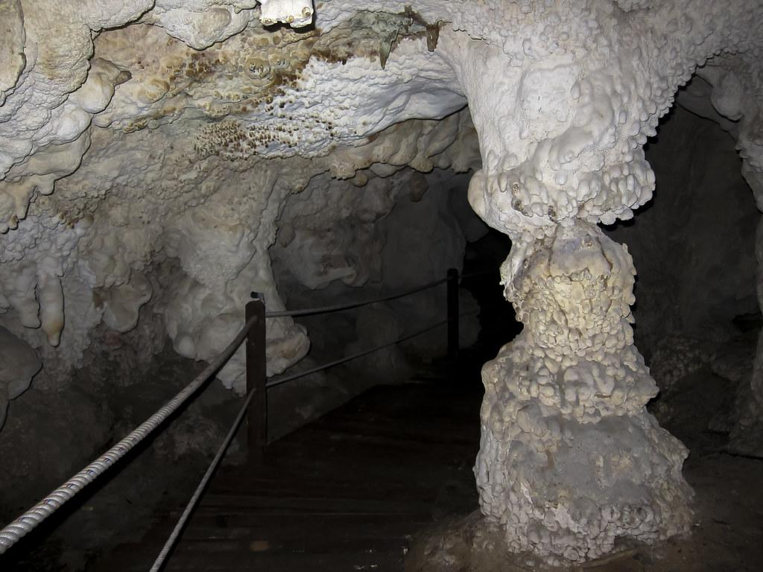
Moonmilk
Moonmilk is a limestone precipitate found in caves
Samples have been found to harbor archaea, bacteria, and fungi
Wikipedia
Notes:
We could also men

Slide 5
Moonmilk
Moonmilk is a limestone precipitate found in caves
Samples have been found to harbor archaea, bacteria, and fungi
Used for medical and cosmetic purposes for thousands of years
First documented in China (~1250-1310 BCE)
Wikipedia
Notes:
We could also men

Slide 6
Moonmilk
Moonmilk is a limestone precipitate found in caves
Samples have been found to harbor archaea, bacteria, and fungi
Used for medical and cosmetic purposes for thousands of years
First documented in China (~1250-1310 BCE)
Actinobacteria have been found to be abundant in moonmilk deposits
Potentially a novel source of natural biological compounds
Wikipedia, Theodorescu et al.
Notes:
We could also men

Slide 7

Question: How does the microbial community of moonmilk microbiome samples vary between different caves?
Hypothesis: Cave location will be the primary driver of microbial diversity in moonmilk. Caves that are closer to each other will have more similar microbial diversity.

Slide 8
Question: How does the microbial community of moonmilk microbiome samples vary between different caves?
Hypothesis: Cave location will be the primary driver of microbial diversity in moonmilk. Caves that are closer to each other will have more similar microbial diversity.

Slide 9
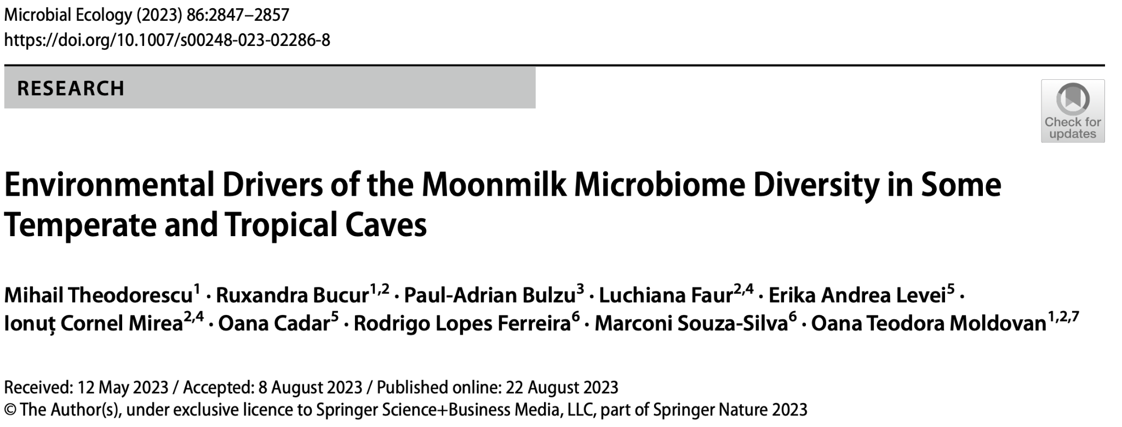

Slide 10
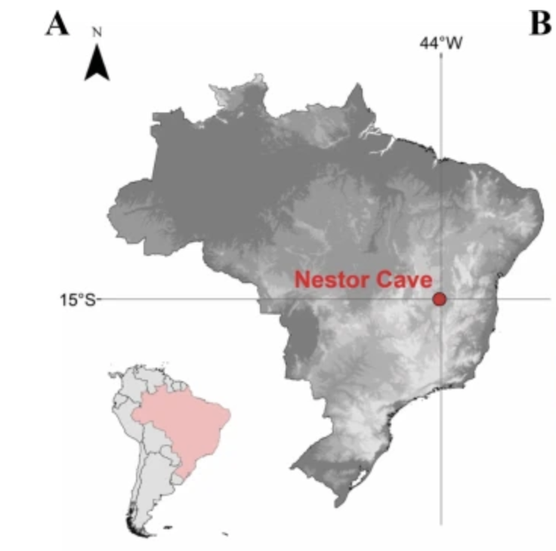
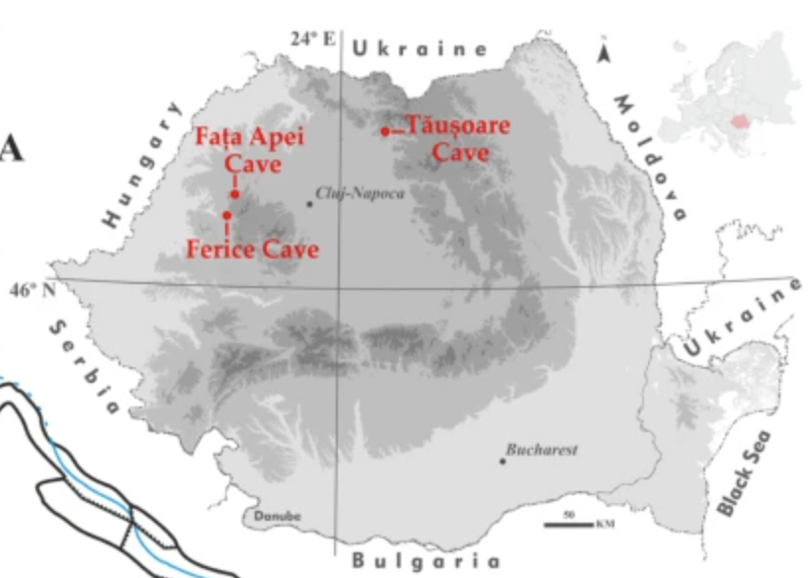
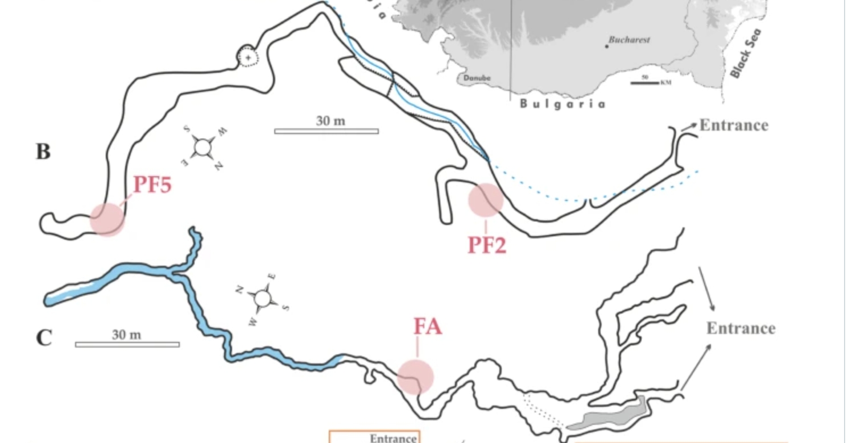
The Caves
Fata Apei: north-western Romania
Ferrice: north-western Romania
Tăușoare: northern Romania
Nestor: south-eastern Brazil

Slide 11
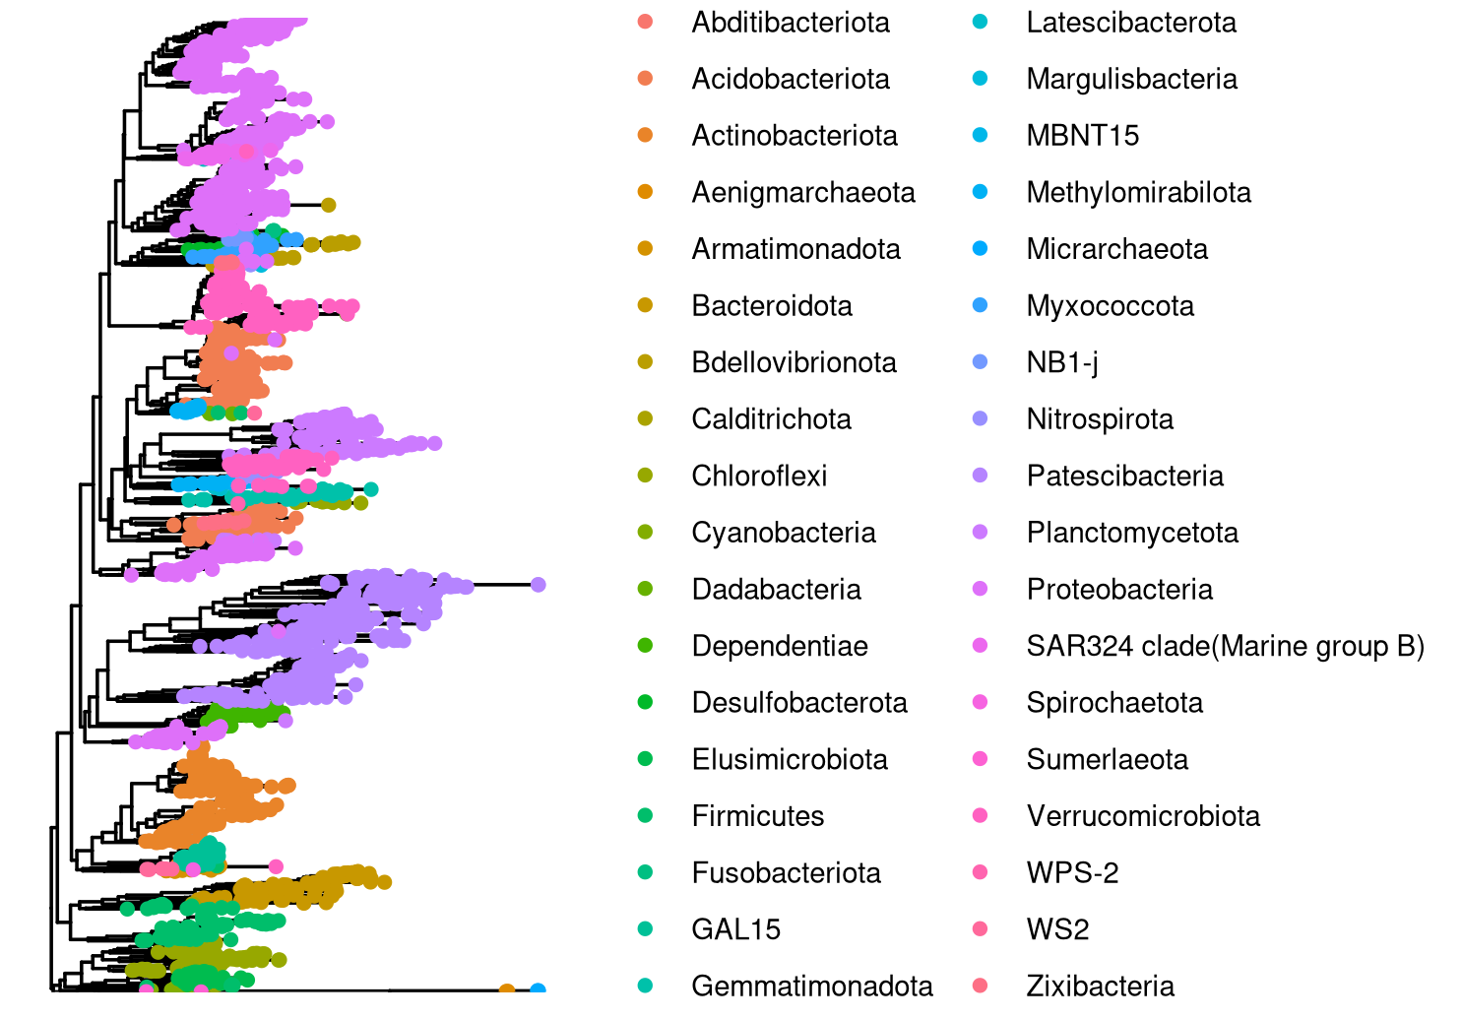
Moonmilk samples are phylogenetically diverse

Slide 12
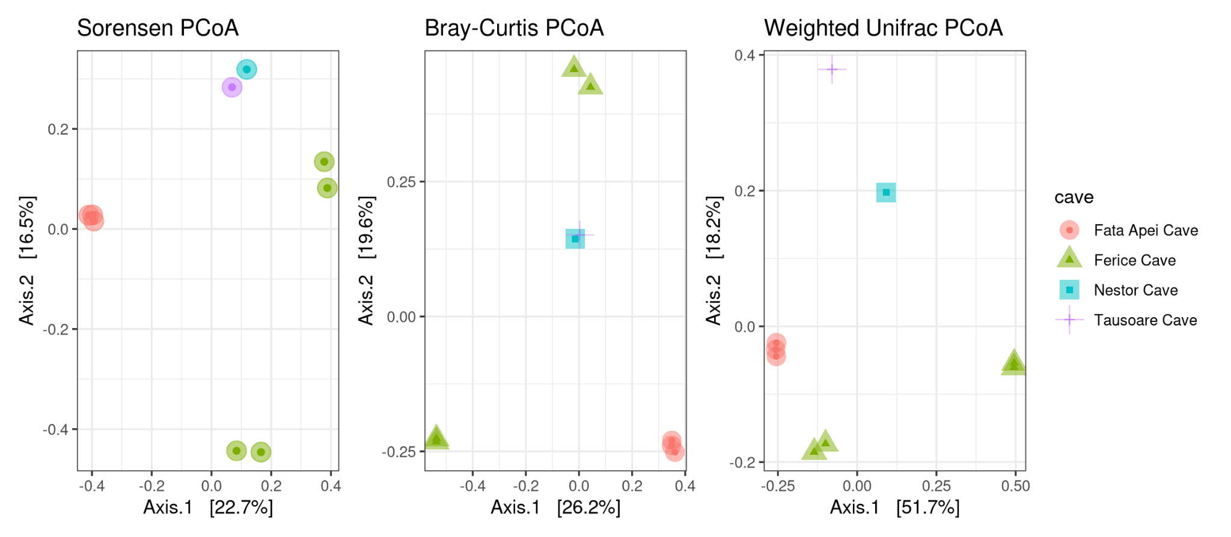
Samples from caves close to each other are not necessarily similar in composition
Notes:
In a PERMANOVA, cave had a p < -.001 for both Sorenson and Bray-Curtis but only p < 0.005 for Weighted Unifrac
R2 for cave was 0.51636, 0.5405, and 0.64567, respectively.
F was 1.7794, 1.9605, and 3.037, respectively.
R2 = the percent variation explained.
F = the F-Statistic, which represents the importance value.
Pr(>F) = the pvalue
Sorensen: Shared Species as a binary value: Abundance-unweighted
Bray-Curtis: Shared Abundant species: Abundance-weighted
(Abundance-)Weighted UNIFRAC: Consider Abundant Species and where they fall on the tree
PCoA: Linear Method. Eigenvalue = how much variation is explained by each axis. Choose to view axis 1, 2, 3, etc. and plot them together.
NMDS: Non-linear. Smush multiple Dimensions into 2 or 3 axes. Need to report Stress value (ideally <0.15).

Slide 13
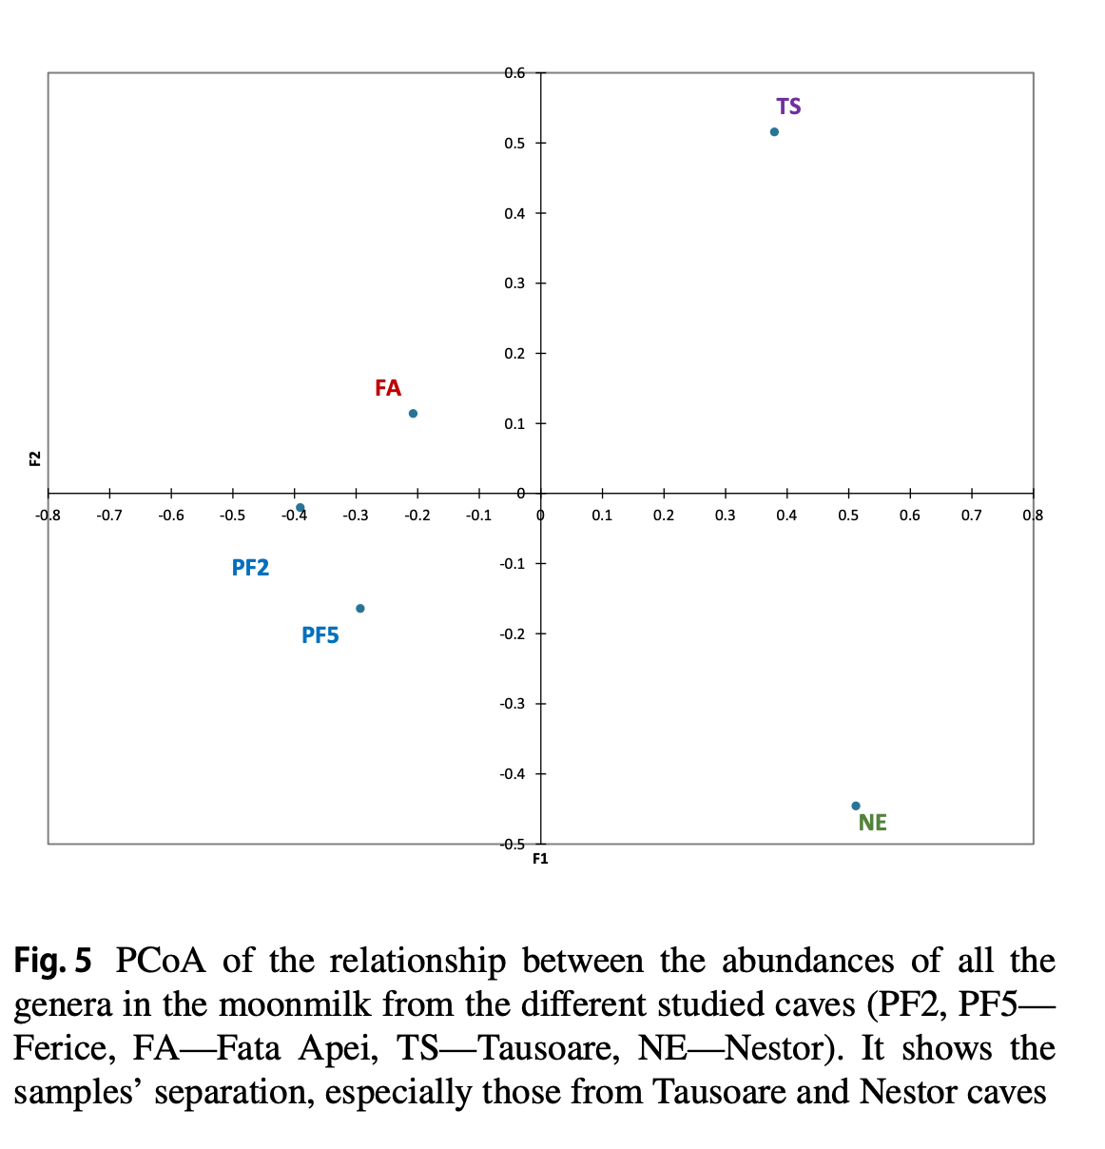
The authors of the paper found:
Ferice and Fata Apei were grouped together
Nestor and Tausoare were separate
Theodorescu et al.

Slide 14
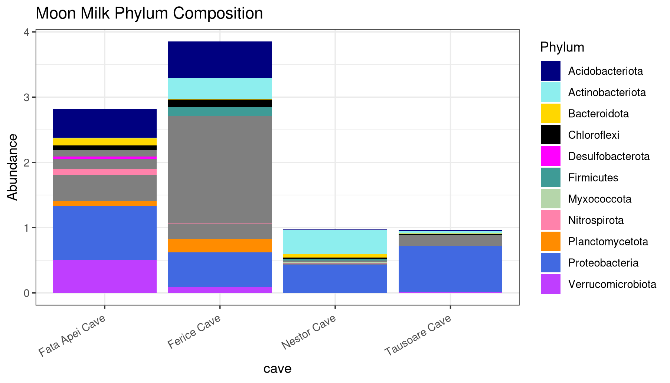
Proteobacteria are the most abundant annotated phylum in moonmilk

Slide 15
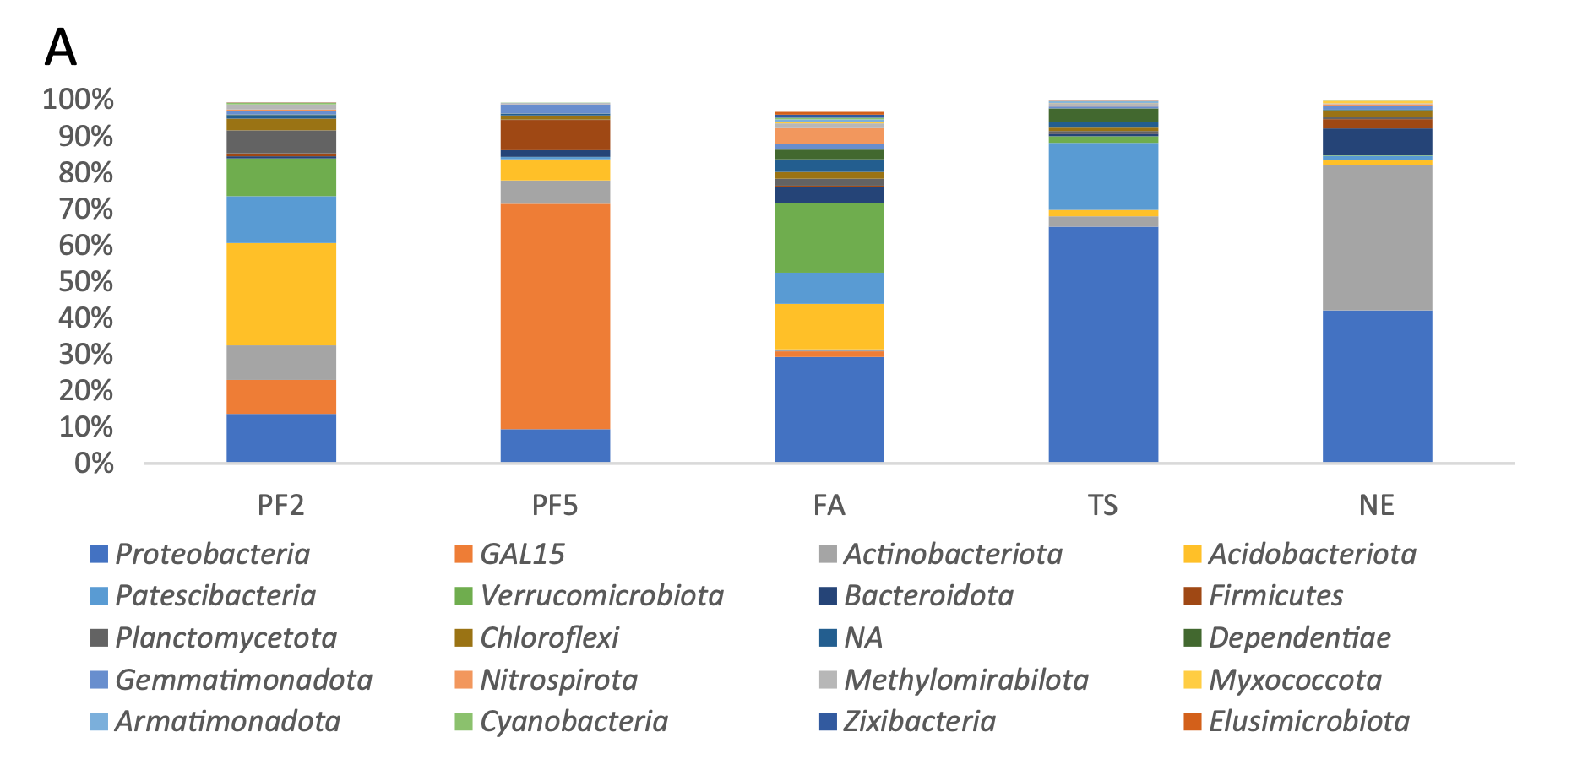
Theodorescu et al.
Notes:
Proteobacteria is the most abundant phyla which matches their results!

Slide 16

Conclusions
Moonmilk samples are phylogenetically diverse
Samples from caves close to each other are not necessarily similar in composition
Proteobacteria are the most abundant annotated phylum in moonmilk, followed by Acidobacteriota
Actinobacteriota are present but not particularly abundant

Slide 17

Photos Used
https://www.flickr.com/photos/anschieber/14742248120/
Theodorescu et al.
Theodorescu et al.
https://www.picng.com/down/14440
https://wallpapers.com/wallpapers/pastel-sailor-moon-wne6gafes63c1o2a.html
https://freepng.pictures/download/moon-3/
https://i.pinimg.com/originals/ad/cb/08/adcb088b101e3c9e891f10f7aa359e7d.jpg

